Slide 1
Communication Systems

Slide 2
Learning Objectives
Describe communication systems and their relevance to distributed systems.
Define characteristics of communication systems and describe related examples.
Discuss the process of transmitting and receiving in communication systems.
State related information processes and issues that relate to communication systems.
Notes:
Students may not know exactly what is meant by globalization or may have an incomplete understanding of the term. You might ask students what they think it means. Potential answers could include: reduction of economic and cultural advantages of developed countries, increased number of companies with operations in multiple countries worldwide, and increased reliance on imports and exports of goods (and jobs). Globalization will be discussed in later slides as well.

Slide 3
Communication Systems
Characteristics of communication systems.
Examples of communication systems.
Transmitting and receiving in communication systems.
Communication Protocols
Communication Topologies
Communication Hardware

Slide 4
Characteristics of Communications Systems
  Protocols
  Handshaking
  Speed of Transmission
  Error Checking
  Communication Settings

Slide 5
Characteristics of Communications Systems
There must be:
a Sender & Receiver
a protocol; a set of rules which governs the transfer of data between computers. Protocols allow communication between computers and networks.
a handshaking process; used to establish which protocols to use. Handshaking controls the flow of data between computers.
a determination of the speed of transmission, error checking method, size of bytes, and whether synchronous or asynchronous.

Slide 6
Examples of Protocols
Token Ring: a protocol which resides at the data link layer of the OSI model. It uses a special three-byte frame called a token that travels around the ring. Token-possession grants the possessor permission to transmit on the medium. Token ring frames travel completely around the loop.
CSMA/CD: described later….
X.25: standard protocol suite for packet switched WAN communication. An X.25 WAN consists of packet-switching exchange (PSE) nodes as the networking hardware, and leased lines, plain old telephone service (POTS) connections or ISDN connections as physical links.
TCP/IP: described later….

Slide 7
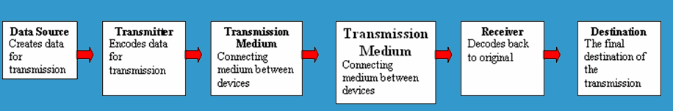
5 Basic Components
Every communication system has 5 basic requirements:
  Data Source: where the data originates
  Transmitter: device used to transmit data
  Transmission Medium: cables or non cable
  Receiver: device used to receive data
  Destination: where the data will be placed.
Figure 1-1: Basic Components

Slide 8
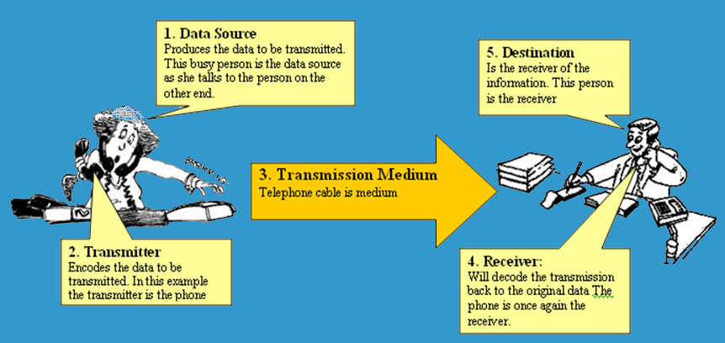
5 Basic Components…
Figure 1-2: Component Interaction

Slide 9
Transmission Media Speed
Bandwidth: The amount of data which can be transmitted on a medium over a fixed amount of time (second). It is measured on Bits per Second or Baud.
Bits per Second (bps): A measure of transmission speed. The number of bits (0 0r 1) which can be transmitted in a second.
Baud Rate: A measure of how fast a change of state occurs (i.e. a change from 0 to 1).

Slide 10
Packets
Transmissions are broken up into smaller units or data transmissions called packets.
Example:
A data file is divided into packets.
It does not matter what the transmission is. It could be Word
document, a PowerPoint or an MP3. Imagine this Green box
is a file for transfer.
This file is broken into four packets
PACKET
PACKET
PACKET
PACKET

Slide 11
Packets and OSI
After the file is divided into packets extra information is required to make sure it all goes back together correctly. The OSI model helps to look after this.
The OSI model also provides much more information which is included with each package.

Slide 12
OSI 7 Layer Model
OSI “Open System Interconnection”
OSI is not a protocol but a list of protocols divided between 7 layers with each layer having a different set of functions.
Each packet is layered/packaged with protocols from each of the layers as it is processed.
The process of layering the protocols around each package is called encapsulation. The final encapsulated data packet is called a frame.

Slide 13
Open Systems Interconnection
OSI Reference Model
  Layer 7 application
  Layer 6 presentation
  Layer 5 session
  Layer 4 transport
  Layer 3 network
  Layer 2 data link
  Layer 1 physical
Sender
Receiver
File
File
File
Each file
is divided
into
packets
Each Packet
will
then be
Encapsulated
with
PROTOCOLS
The protocols
Will be added
systematically
Layer
By layer
The encapsulated
Packet is called
a frame
The received
frame is then
unpacked
in the
opposite order
Transmission Medium
Figure 1-3: The OSI Reference Model

Slide 14
Services Performed at Each Layer
  Layer 7 Application
  Layer 6 Presentation
  Layer 5 Session
  Layer 4 Transport
  Layer 3 Network
  Layer 2 Data Link
  Layer 1 Physical
  Identification, authentication
  Format conversion
  Set-up, coordinate conversation
  Ensures error-free transfer
  Routing of data through network
  Error control and synchronisation
  Placing signals on the carrier
Figure 1-4: Services

Slide 15
Examples of Protocols
  Layer 7 App.
  Layer 6 Pres.
  Layer 5 Session
  Layer 4 Transport
  Layer 3 Network
  Layer 2 Data Link
  Layer 1 Physical
  POP, SMTP:E-mail, FTP: Files, HTTP, DNS
  JPEG, TIFF, PNG, GIF
  Sockets
  TCP, UDP, ATM, Frame Delay
  IP(IPv4, IPv6), ARP, RARP, ICMP, RSVP, IPSec.
  PPP, Ethernet, Token ring
  100baseT
Figure 1-5: Examples of Protocols

Slide 16
Encapsulation
Device 1
Device 2
Application
data
Application
Presentation
H6
data
T6
Presentation
Session
H5
data
T5
Session
Transport
H4
data
T4
(Packet)
Transport
Network
H3
data
T3
(packet)
Network
Data Link
H2
data
T2
Data Link
Physical
H1
data
T1
Physical
carrier
FRAME
FRAME
FRAME
FRAME
A typical frame
Preamble
Destination
Address
Source
Address
Data
Padding
CRC
Figure 1-6: Encapsulation

Slide 17
Error Checking Methods
Parity bit check
Check sum
  data transmitted in blocks, each block added to give a total – checksum
  used in X Modem protocol
Cyclic redundancy check: transmitted messages divided into predetermined lengths that are divided by a fixed divisor. Remainder number is appended onto and sent with the message. Upon receipt, the receiver recalculates the remainder and compares it to the transmitted remainder. If the numbers do not match, an error is detected.

Slide 18
Error Checking Methods…
Parity bit Check:
  use of parity bits to check that data has been transmitted accurately. The parity bit is added to every data unit (typically seven or eight bits ) that are transmitted. The parity bit for each unit is set so that all bytes have either an odd number or an even number of set bits.

Slide 19
Error Checking Methods…
Checksum:
  each transmitted message is accompanied by a numerical value based on the number of set bits in the message. The receiving station then applies the same formula to the message and checks to make sure the accompanying numerical value is the same. If not, the receiver can assume that the message has been garbled.

Slide 20
Error Checking Methods…
Cyclic redundancy check:
  transmitted messages divided into predetermined lengths that are divided by a fixed divisor. Remainder number is appended onto and sent with the message. Upon receipt, the receiver recalculates the remainder and compares it to the transmitted remainder. If the numbers do not match, an error is detected.

Slide 21
Communication Systems
Characteristics of communication systems.
Examples of communication systems.
Transmitting and receiving in communication systems.
Communication Protocols
Communication Topologies
Communication Hardware

Slide 22
Examples of Communication Systems
- E-mail
- Voice Mail - Fax
- Smart Phone - Instant Messaging
- Telecommuting - Video-conferencing
- Groupware - Telephony
- E-Commerce - The Internet
Bulletin board system - The Web
- Global positioning system

Slide 23
Communications Systems
Characteristics of communication systems.
Examples of communication systems.
Transmitting and receiving in communication systems.
Communication Protocols
Communication Topologies
Communication Hardware

Slide 24
Transmitting and Receiving in Communication Systems
Communication concepts
  Transmission of data, protocols and handshaking, networks, LANs and WANs, Topologies, Network Access Methods.
Network Hardware
  (NICs, Servers, Routers and Switches, Bridges and gateways, Hubs, Transmission media.
Network Software
NOSs, Network Operating System Tasks, Logon and Logoff Procedures, Intranets and Extranets.

Slide 25
Communication Concepts
Any transmission May be:
  Analog: a transmission method of conveying info. using a continuous signal which varies in amplitude, phase, or some other property in proportion to that of a variable or;
  Digital: the physical transfer of data over a point-to-point or point-to-multipoint communication channel.
  Serial: Data is transmitted, on a single channel, one bit at a time one after another or;
  Parallel: each bit has it’s own piece of wire along which it travels. Often used to send data to a printer.

Slide 26
Serial Transmission
Much faster than parallel because of way bits processed (e.g. USB and SATA drives)
Sender transmitted
Receiver received
1
0
0
1
1
0
0
1
Figure 1-7: Serial Transmission

Slide 27
Parallel Transmission
1
0
0
1
Receiver received
Sender transmitted
1
0
0
1
All bits are sent simultaneously
Figure 1-8: Parallel Transmission

Slide 28
Why not use Parallel instead of Serial?
Due to inconsistencies on channels data arrives at different times.
Because of the way it is transmitted packet switching cannot be used.
The above two points make parallel slower than serial and requires higher bandwidth.
Parallel transmissions are rarely used anymore.

Slide 29
Synchronous vs Asynchronous Transmissions
Synchronous Transmission: all data sent at once and no packet switching.
Asynchronous Transmission:
  Uses stop/start bits
  most common type of serial data transfer
  Allows packet switching
  Allows sharing of bandwidth (i.e. talk on phone while another person is using internet)

Slide 30
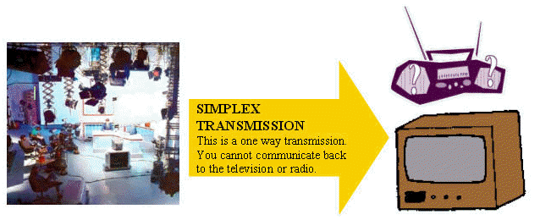
Transmission Direction
Simplex: One direction only
Figure 1-9: Simplex Transmission

Slide 31
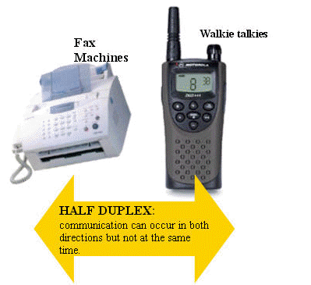
Half Duplex Transmission
Half Duplex: Both directions but only one direction at a time.
Figure 1-10: Half Duplex Transmission

Slide 32
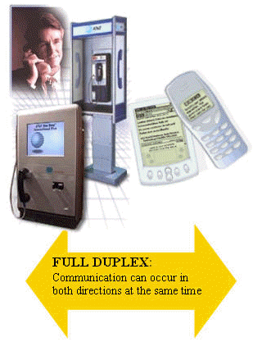
Full Duplex Transmission
Full Duplex: send and receive both directions at once.
Figure 1-11: Simplex Transmission

Slide 33
Communications Systems
Characteristics of communication systems.
Examples of communication systems.
Transmitting and receiving in communication systems.
Communication Protocols
Communication Topologies
Communication Hardware

Slide 34
3 Common Protocols
Ethernet (Ethernet Network): A Physical and Data Link Layer technology for local area networks (LANs).
Carrier Sense Multiple Access/Collision Detection (CSMA/CD): A medium access control (MAC) method used most notably in local area networking using early Ethernet technology.
TCP/IP: The suite of communication protocols used to connect hosts on the Internet. TCP/IP uses several protocols, the two main ones being TCP and IP.

Slide 35
Ethernet
A system for connecting a number of computer systems to form a local area network, with protocols to control the passing of information and to avoid simultaneous transmission by two or more systems.
Developed at Xerox in 1976 by Robert Metcalfe.
First protocol approved as an industry standard protocol 1983.
Most popular LAN protocol as its inexpensive.

Slide 36
Carrier Sense Multiple Access/Collision Detection (CSMA/CD)
It uses a carrier sensing scheme in which a transmitting data station detects other signals while transmitting a frame, and stops transmitting that frame, transmits a jam signal, and then waits for a random time interval before trying to resend the frame.
Used to improve CSMA performance by terminating transmission as soon as a collision is detected, thus shortening the time required before a retry can be attempted.
Used on bus networks to avoid data collisions.

Slide 37
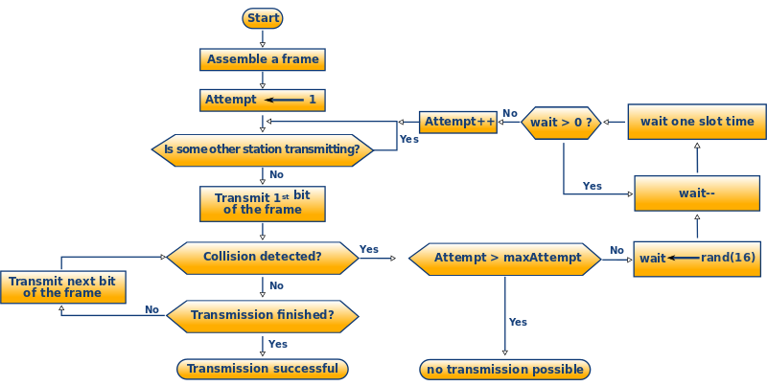
Carrier Sense Multiple Access/Collision Detection (CSMA/CD)…
Figure 1-12: Simplified Algorithm of CSMA/CD

Slide 38
TCP/IP
Developed in 1973 for use on the Advanced Research Projects Agency NET (ARPANET) which was a defense force research network.
Adopted in 1983 as the Internet standard. all hosts on the Internet are required to use TCP/IP.
Allows transfer of data using packet switching.
Built into the UNIX OS and is used by the Internet, making it the de facto standard for transmitting data over networks.

Slide 39
Communications Systems
Characteristics of communication systems.
Examples of communication systems.
Transmitting and receiving in communication systems.
Communication Protocols
Communication Topologies
Communication Hardware

Slide 40
LANs Vs WANs
LAN: “local Area network”: a network confined to a small geographic area typically a building or a group of buildings; provides networking capability to a group of computers in close proximity to each other such as in an office building, a school etc.
WAN: “wide area network”: a network spread over a large geographic area. covers a broad area (i.e. any telecoms network that links across metropolitan, regional, national or international boundaries) using leased telecoms lines.The largest WAN is the Internet.

Slide 41
Examples of LANs
3 different types of LANS:
  Ring: each node connects to exactly two other nodes, forming a single continuous pathway for signals through each node - a ring. Data travels from node to node, with each node along the way handling every packet.
  Bus: an arrangement in a LAN in which each node (workstation or other device) is connected to a main cable or link called the bus.
  Star: a LAN in which all nodes (workstations or other devices) are directly connected to a common central computer.

Slide 42
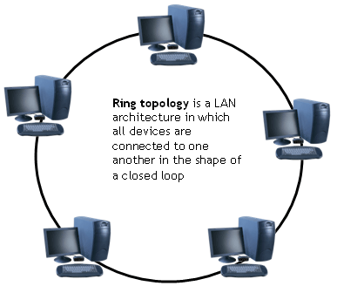
Ring Topology
Uses an empty data packet called a token and a special protocol called “token ring”.
Packets travel around the ring in a clockwise direction. Clients require an empty token to transmit data.
Advantage:
no collisions because all data travels in same direction.
Disadvantage:
fails if an individual node in the network fails
Figure 1-13: Ring Topology

Slide 43
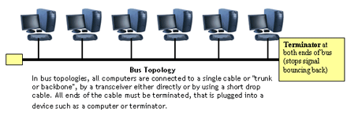
Bus Topology
Figure 1-14: Bus Topology
A bus is a form of Ethernet. Nodes linked by a cable known as the bus. Bus transmits in both directions and uses CSMA/CD protocol.
Advantages - Easy to set up and maintain failure of one node does not affect network. | Disadvantages Higher rate of data collision than with a bus network. fails if there is any damage to the bus.
Notes:
Easy to add extra computers . If computer goes down it doesn’t affect rest of network

Slide 44
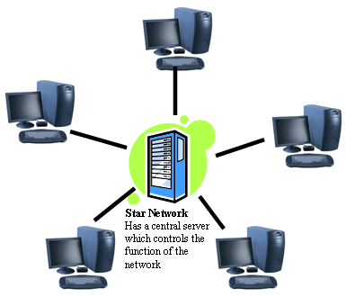
Star Topology
All data is sent from one client to another through the server.
Advantage:
If one client fails no other clients are affected.
Disadvantage:
If central file server fails the network fails.
Figure 1-15: Star Topology
Notes:
If central host goes doewn affects rest of network

Slide 45
What is a Network?
A network is a number of computers & peripheral devices connected together so as to be able to communicate (i.e. transfer data).
Each device in a network is called a node.
Terminals are data entry points which can also display.

Slide 46
Networks: categorized by size
LAN: a network that connects computers in a limited
geographical area.
MAN: a backbone that connects LANs in a metropolitan area such as a city and handles the bulk of communications activity across that region.
WAN: covers a large geographical area such as a city or country. Communication channels include telephone lines, Microwave, satellites, etc.
Notes:
LAN local area network

Slide 47
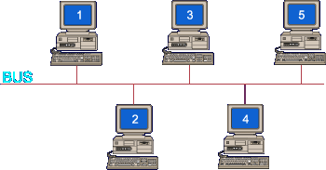
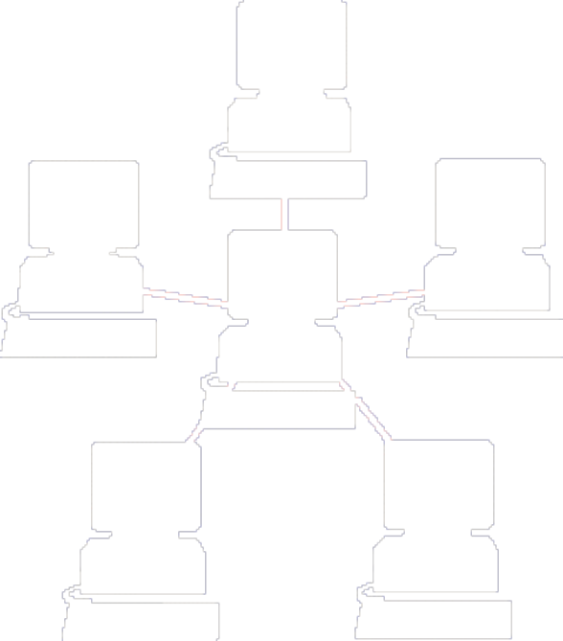
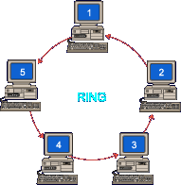
Network Topologies (Categorized by shape)
Figure 1-16: Topologies by shape
Notes:
Contention occurs on star and bus networks.

Slide 48
Communications Systems
Characteristics of communication systems.
Examples of communication systems.
Transmitting and receiving in communication systems.
Communication Protocols
Communication Topologies
Communication Hardware

Slide 49
Bridge
Large networks can be separated into two or more smaller networks using a bridge. This is done to increase speed and efficiency. This type of network is called a segmented LAN and has largely been superseded by the use of switches which can transfer data straight to a computer and thus avoid bottleneck jams which bridges were designed to fix.
Bridge
Figure 1-17: Bridge
Notes:
Devives that connect local area networks
If a BUS or ring then a Gateway needs to be used

Slide 50
Gateway
Often used to connect a LAN with a WAN. Gateways join two or more different networks together.
Gateway
Figure 1-18: Gateway

Slide 51
Internet, Intranet, Extranet
Internet: public/international network which is used to access information, e-shopping, e-banking, email
Intranet: private network (LAN or WAN) used to share resources in secure environment. It uses web pages (HTML to view) and TCP/IP protocols (to make connection).
Extranet: intranet that has been extended to include access to or from selected external organizations such as customers, but not general public. Connections are via leased lines, or network interconnections.

Slide 52
Transmission Media
Twisted pair: Telephone cable
Coaxial cable: Thick black cable used for higher bandwidth communications than twisted pair (i.e. Optus cable).
Fibre optic: Data transferred through pulses of light. Extremely fast.
Non cable methods: E.g. as satellite, microwave, wireless and Bluetooth.

Slide 53
Network Hardware
Servers: Help to manage the network and the resources of that network. On larger networks servers commonly have specialised tasks such as: File Servers: store and manage files, Print Servers: manage printers and print jobs, Mail Servers: Manages email, Web Servers: manage web access.
Routers: connects multiple networks and are protocol independent. Can be used in place of a switch or bridge.
Switches: smart hubs which transmit packets to the destination port only.
Hubs: like double adapters /power boards in the home except instead of plugging in extension cords we plug in computers to allow them to communicate.

Slide 54
Next Week…
Naming, Consistency & Replication

